Slide 1
^{Propionic Acid Toxicity Assay}
-Plate preparation (24 well plates)
PA final concentration (mM) | 0 | 20 | 40 | 60 | 80 | 100 | 120 | 140
PA stock (2M) volume (ml) | 0 | 2 | 4 | 6 | 8 | 10 | 12 | 14
ddH2O volume (ml) | 14 | 12 | 10 | 8 | 6 | 4 | 2 | 0
NGM medium (ml) | 186 | 186 | 186 | 186 | 186 | 186 | 186 | 186
Total volume (ml) | 200 | 200 | 200 | 200 | 200 | 200 | 200 | 200
-12 strains
strain1 | strain2 | strain3 | strain4 | strain5 | strain6
CX11314 | EG4725 | JU775 | MY23 | JT11398 | MY16
strain7 | strain8 | strain9 | strain10 | strain11 | strain12
CB4856 | JU258 | DL238 | N2 | E03017 | LKC34

Slide 2
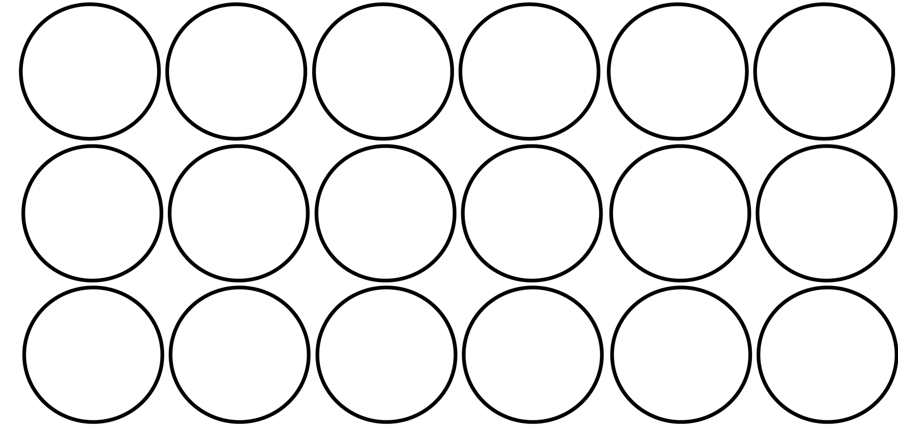
-Data collection
strain1 | strain2 | strain3 | strain4 | strain5 | strain6
CX11314 | EG4725 | JU775 | MY23 | JT11398 | MY16
strain7 | strain8 | strain9 | strain10 | strain11 | strain12
CB4856 | JU258 | DL238 | N2 | E03017 | LKC34
triplicate
1. Synchronized L1 worms were seeded on to plates on day0
2. Worms grow over L1 and arrested were counted separately on day2
3. Survival rate was calculated by:
Worms grow over L1
X
100%
Worms grow over L1 + arrested L1

